Slide 1
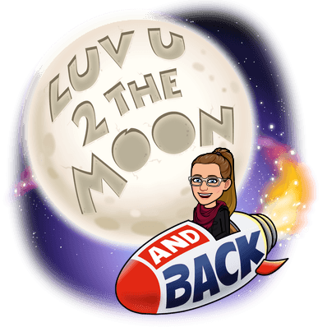
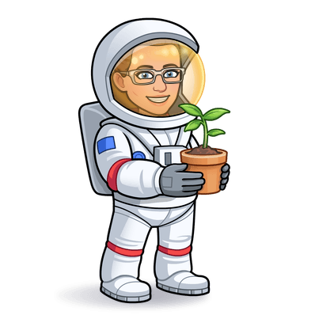
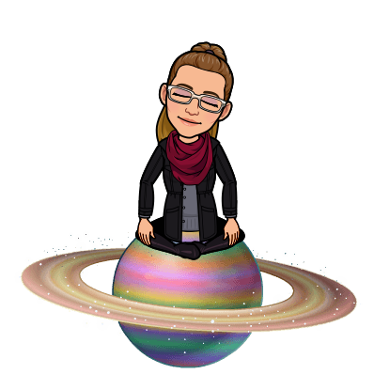
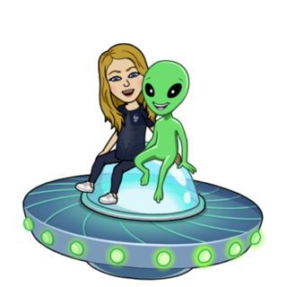
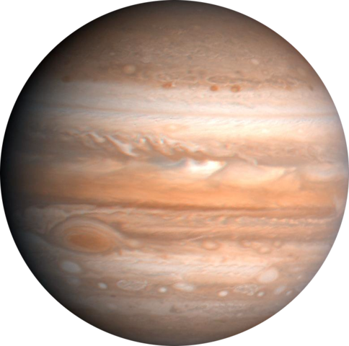
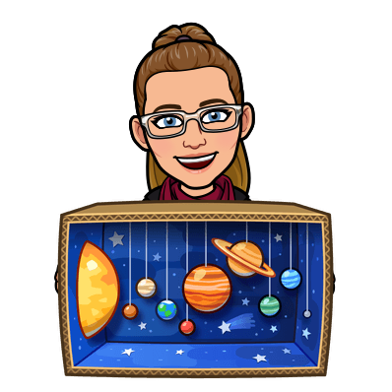
STEAM’s Countdown to
Winter Break!
Let’s get Spacey!

Slide 2
Day 1 Challenge:
Take a selfie of you doing something that you love.
Write 5 adjectives to describe this activity.
5 adjectives to describe space are: vast, expansive, infinite, starry and incomprehensible.

Slide 3
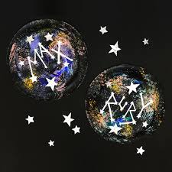
Day 2 Challenge: Write your name in the stars.
Did you know the sun is the only star in our solar system?

Slide 4
Day 3 Challenge: Did you know that the moon has six times less gravity than earth? Can you do the math to determine your weight on the moon?
Example:
100 lbs on earth = 16.6 lbs on the moon.

Slide 5
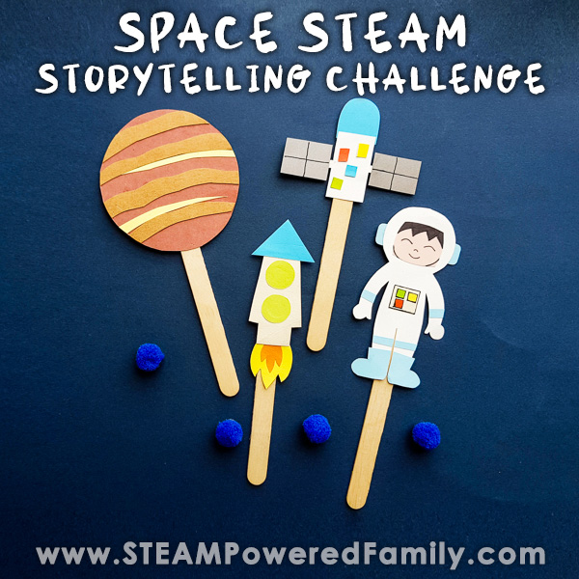
Day 4 Challenge:
Can you write a short story set in space and then animate it with coding, puppetry, green screens or whatever creative way you can think of? Share your stories with Ms. Allen or Mrs. Sarduy. They are sure to be out of this world!

Slide 6
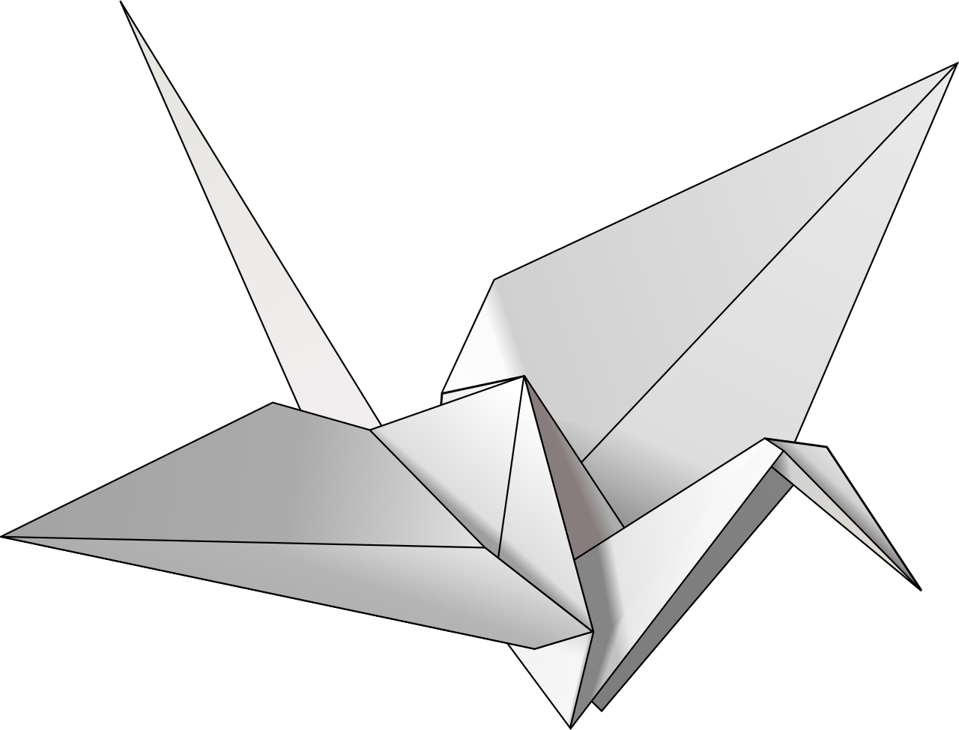
Day 5 Challenge:
Did you know the Webb telescope was the largest telescope ever placed in Space. Thanks to this telescope we have clearer pictures than ever before. The challenge for NASA engineers was trying to figure out how to get it to Space. So they had to use origami style technology. Can you make an origami creation?

Slide 7
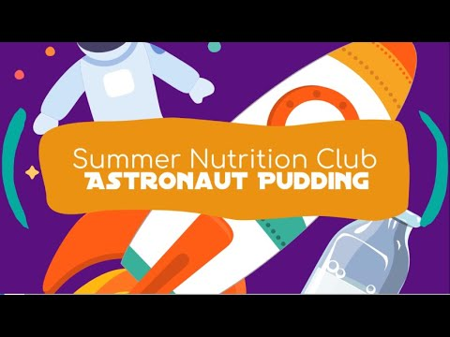
Day 6 Challenge:
Science is fun...create some astronaut pudding and then watch Artemis’ return to earth!

Slide 8
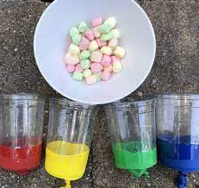
Day 7 Challenge: Rockets have to have enough force to overcome the force of gravity on earth. Can you create a device that propels a marshmallow or cotton ball into the air? Once successful it is time for a Florida snowball fight!

Slide 9
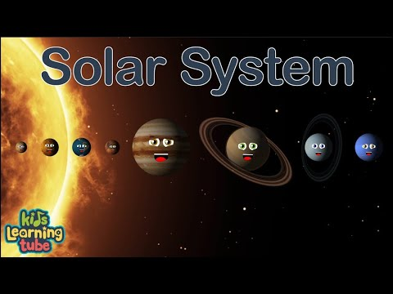
Day 8 Challenge: Our solar system has 8 planets. Can you learn and sing a solar system song?

Slide 10
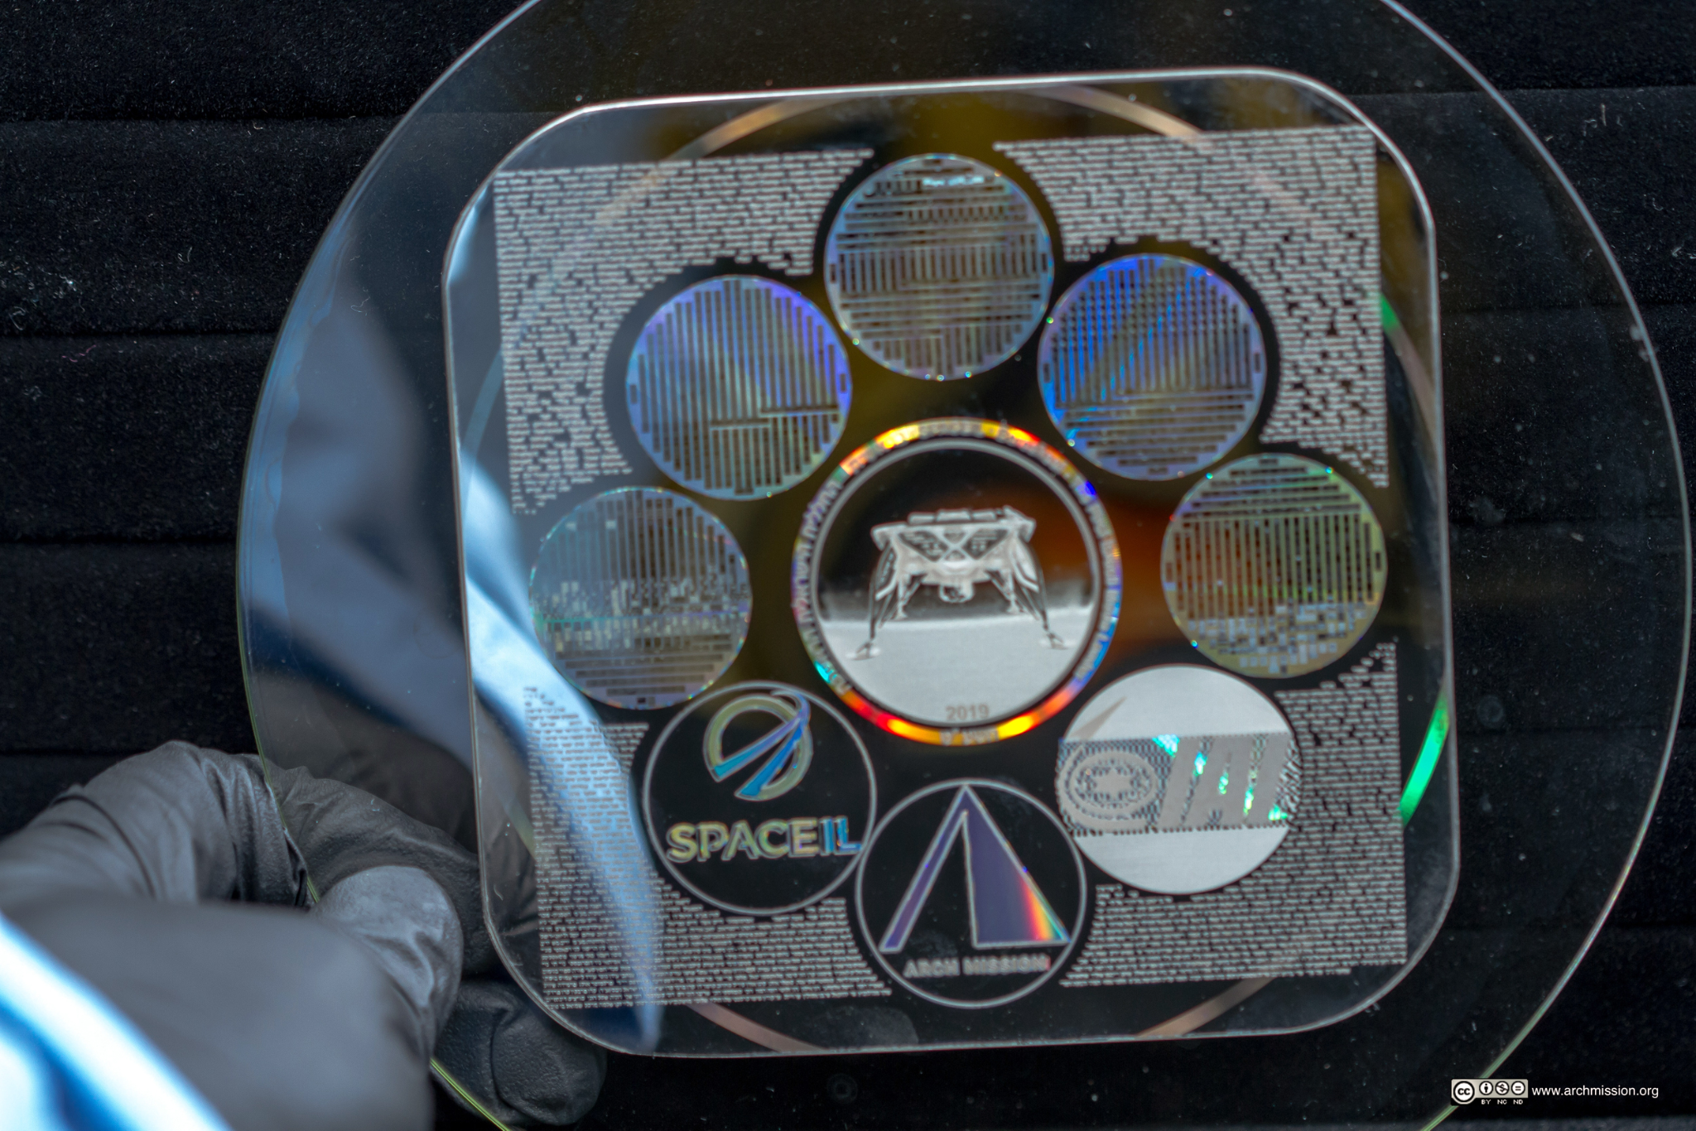
Day 9 Challenge: Did you know there is a library in space? The Lunar Library contains a 30 million page archive of human history and civilization, covering all subjects, cultures, nations, languages, genres, and time periods. The Library is housed within a 100 gram nanotechnology device that resembles a 120mm DVD. Take some time today and read a book just like the astronauts do in space!

Slide 11
Day 10 Challenge:
Did you know that Kennedy Space Center, located here in Central Florida, is the launching point for every manned mission to space?
Make a list of 5 other places in Florida that make Florida unique?

Slide 12
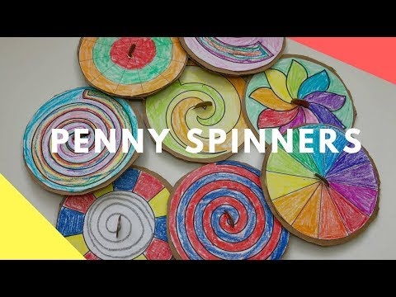
Day 11 Challenge:
Create a galaxy penny spinner..
Did you know that galaxies are made up of stars, gas dust, solar systems, all held together by gravity. Our galaxy is called the Milky way.
D

Slide 13
Day 12 Challenge:
Using Tinkercad.com or design on a sheet of paper. Create your own Mission Patch. Take a picture of your design and send it to Ms. Allen or Mrs. Sarduy to be part of our Mission Patch Challenge. All Submissions are due by January 10th. The winners will be announced and their patches will be created on the 3D printer.

